Slide 1
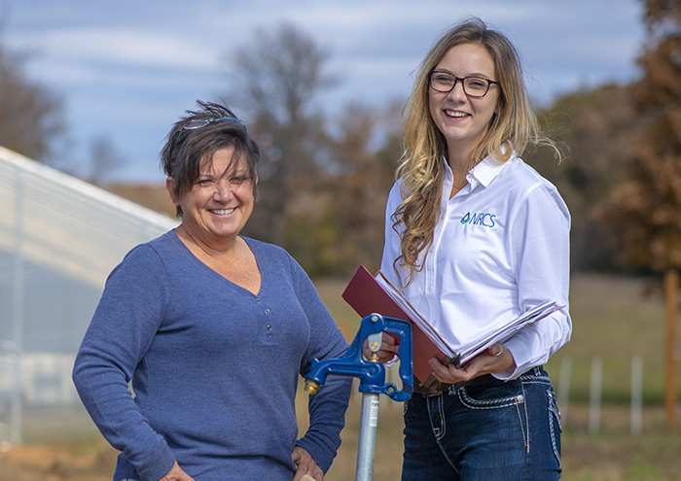
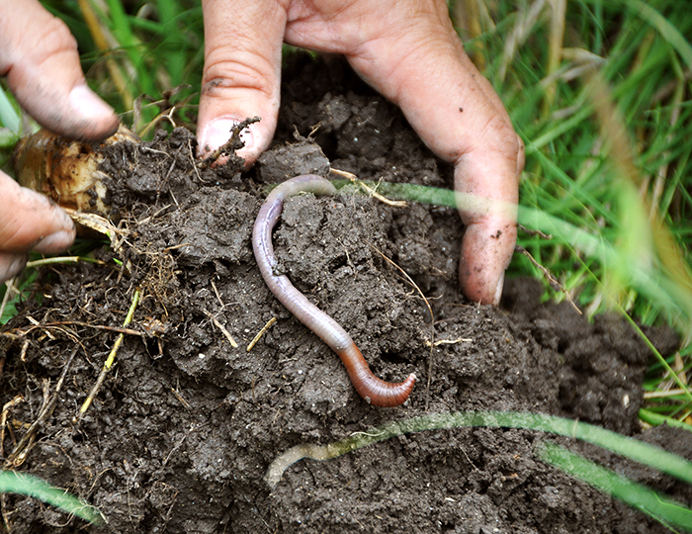

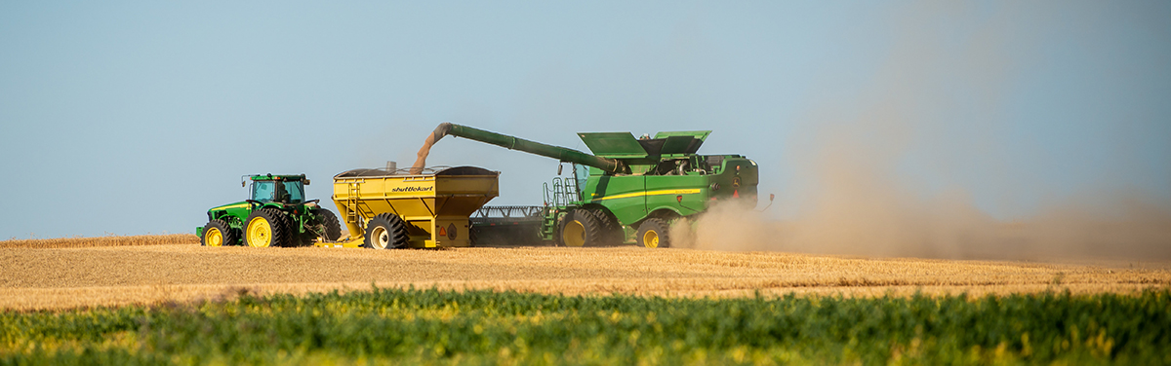
RCA Data
Andi Neugebauer-Bailey
State Resource Conservationist
USDA/NRCS - Wyoming

Slide 2
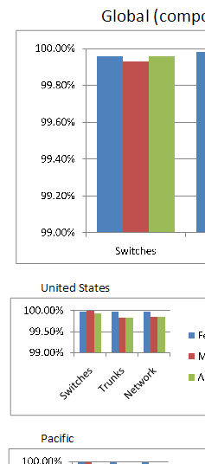

RCA Data
What does RCA stand for?
What data is available?
Why would I need this data?
Who is this data available to?

Slide 3
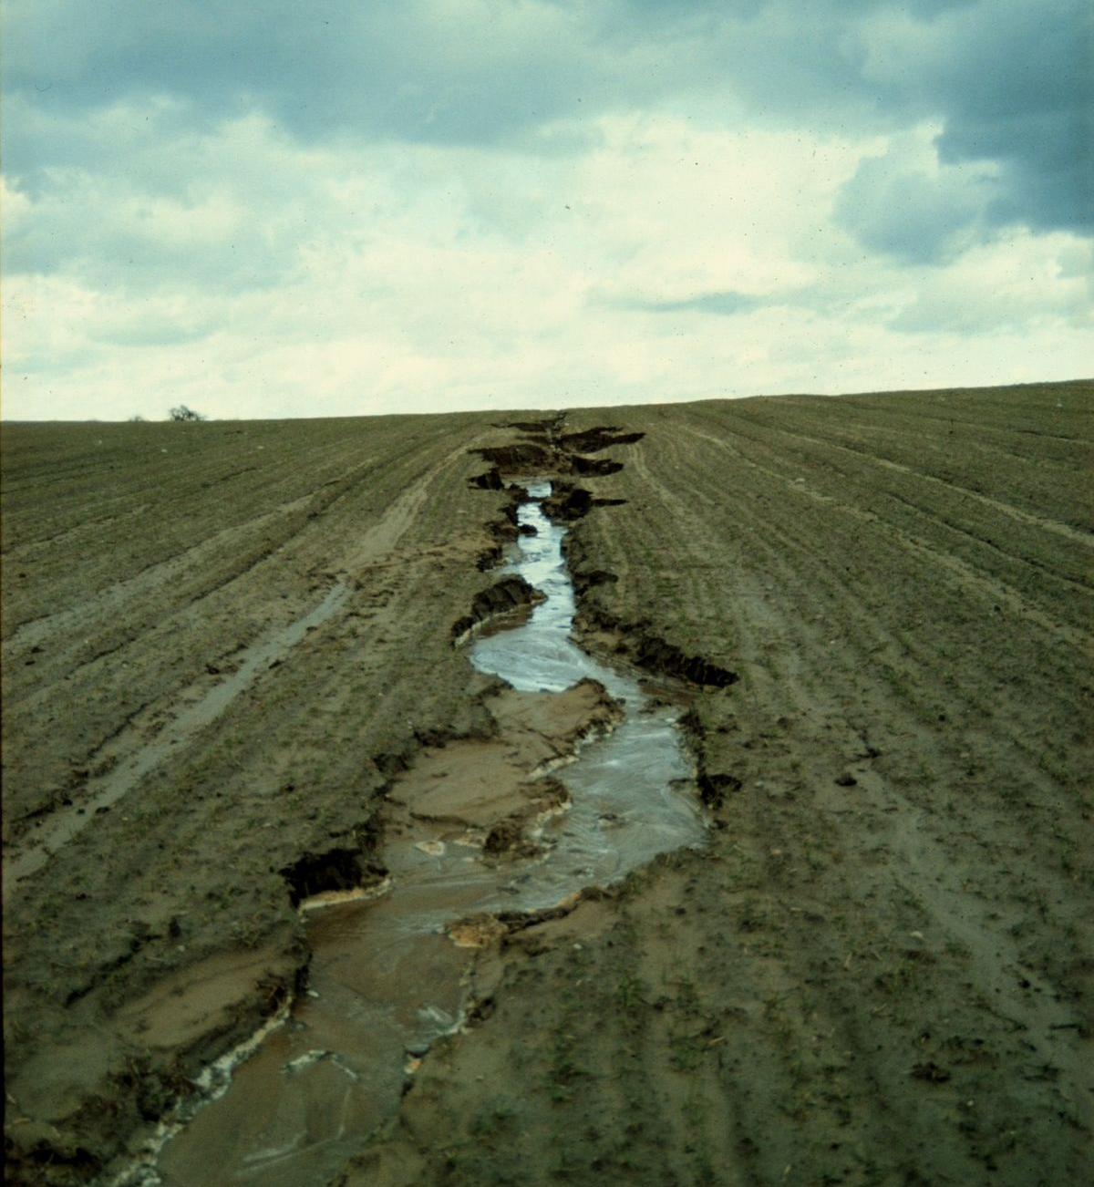
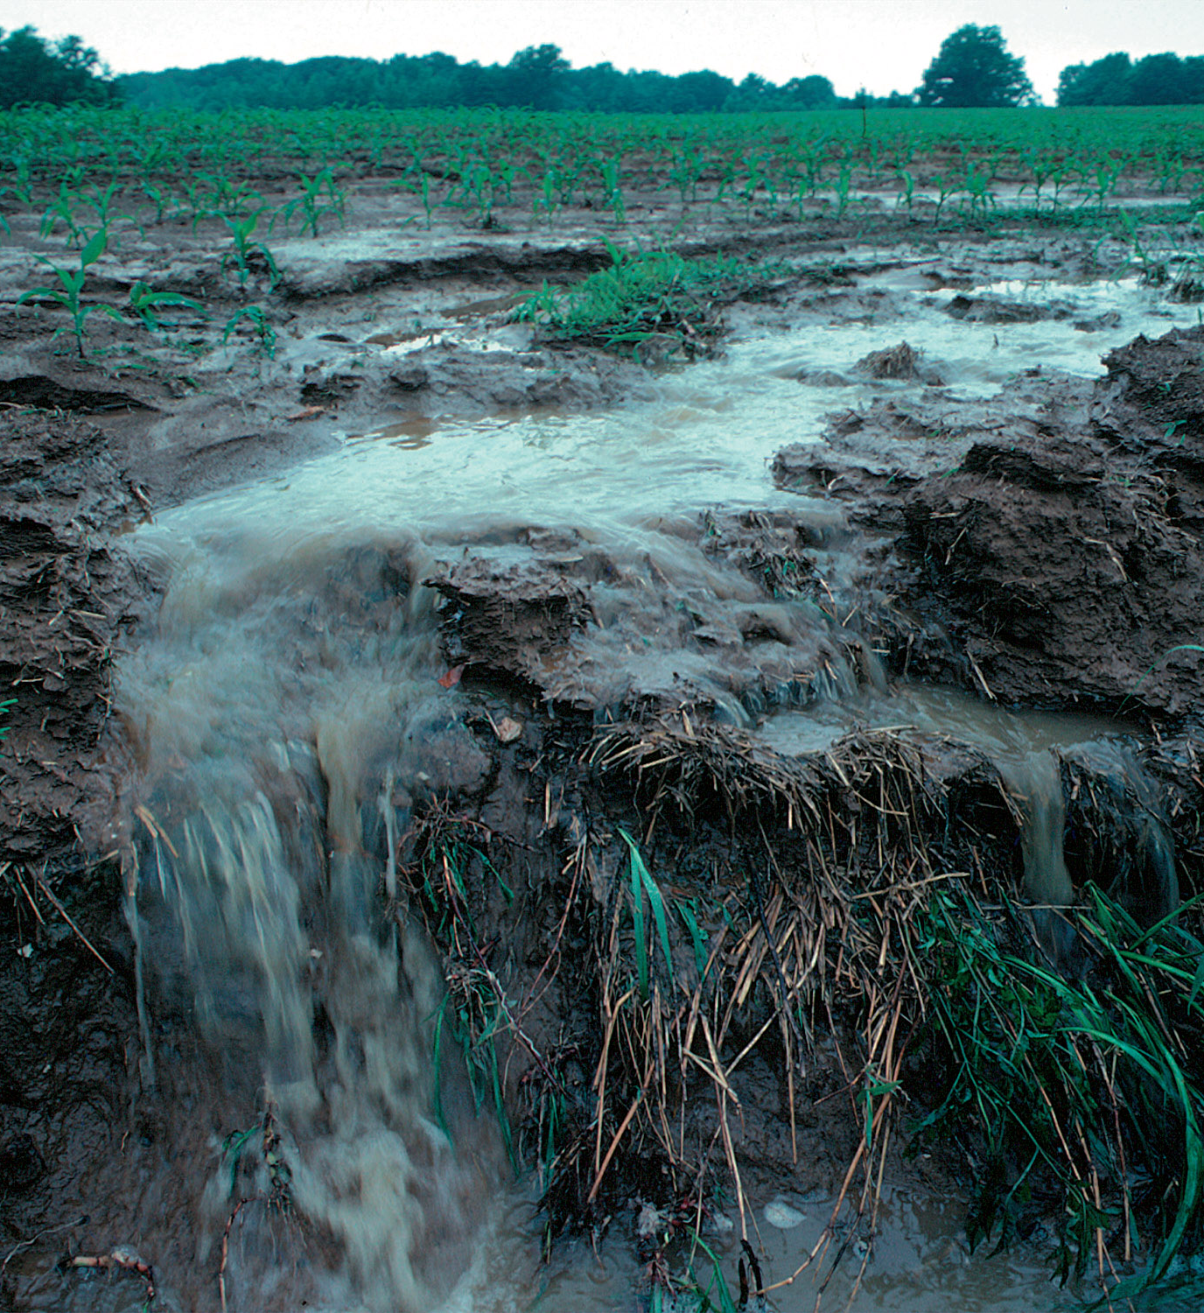
What is RCA?
The Soil and Water Resources Conservation Act (RCA) of 1977, as amended, provides the United States Department of Agriculture (USDA) broad strategic assessment and planning authority for the conservation, protection, and enhancement of soil, water, and related natural resources.
This Photo by Unknown Author is licensed under CC BY-SA
Notes:
Resource Conservation Act is broad strategic assessment and planning authority for the conservation, protection, and enhancement of soil, water, and related natural resources

Slide 4
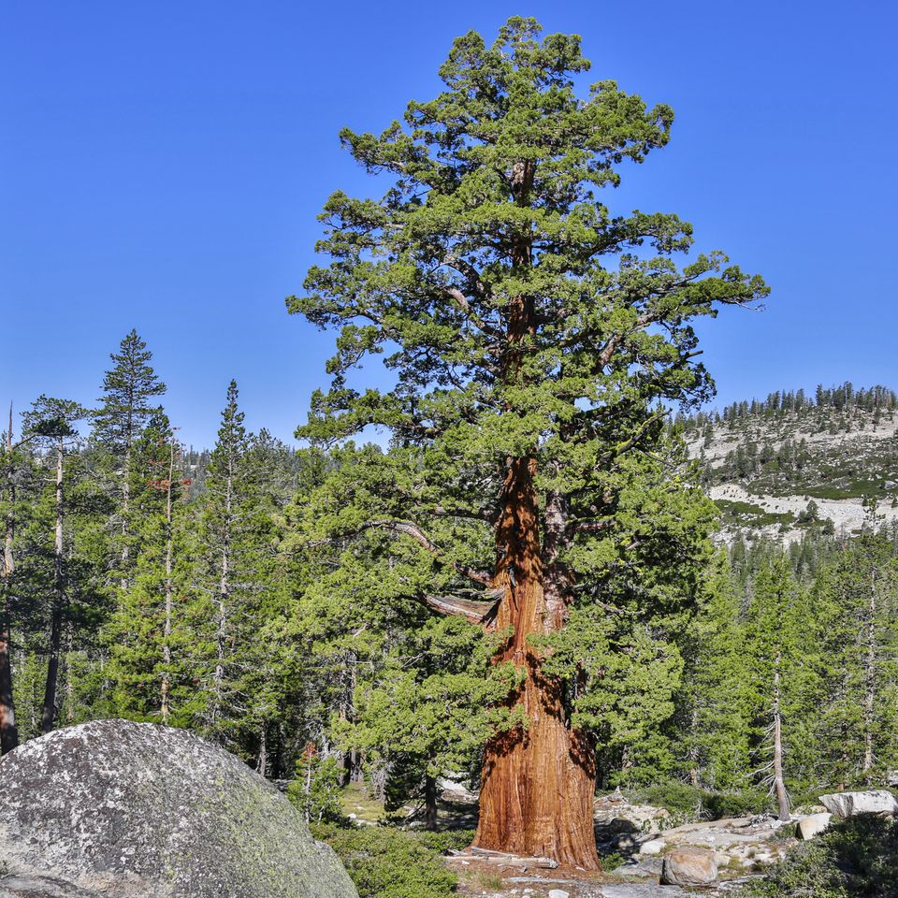
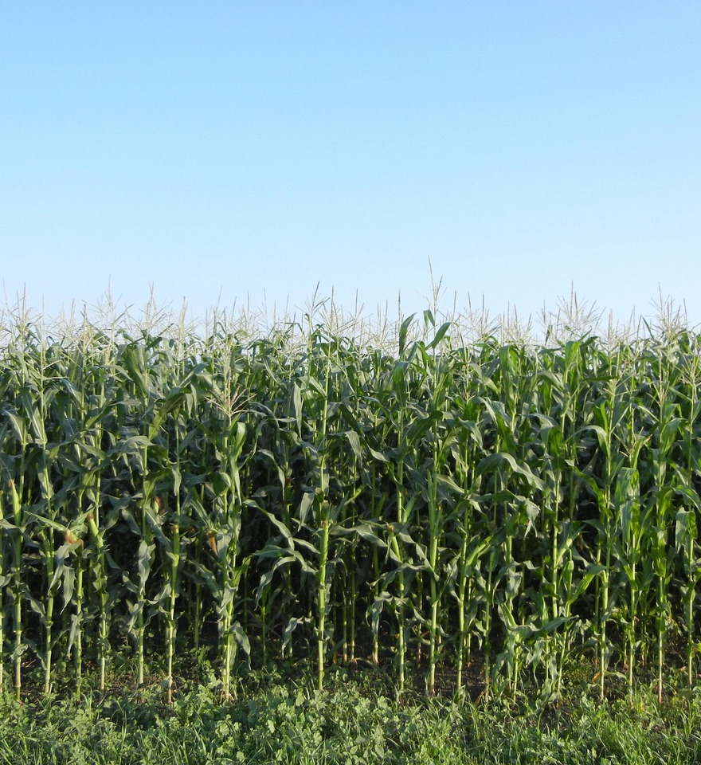
Through RCA, USDA:
Appraises the status and trends of soil, water, and related resources on non-Federal land and assesses their capability to meet present and future demands;
Evaluates current and needed programs, policies, and authorities; and
Develops a national soil and water conservation program to give direction to USDA soil and water conservation activities.
Notes:
Determine status and trends of resources on private lands and assess their capability to meet demands.
Evaluates Current programs, and what NRCS may need
Direct soil and water conservation activities

Slide 5
What data is available?
NRCS documents the effects of conservation practices and systems so that better decisions can be made, and risk is managed more effectively. NRCS cooperates with other Federal and State agencies and conservation partners to collect and analyze natural resource data.
NRCS Financial Assistance Programs
Easements
Financial Obligations
Practices Applied
Acres receiving Conservation
Land Use Trends
Cropland Soil Erosion and much more!

Slide 6



Why would I need this data?
NRCS cannot share data that contains PII or is protected by Section 1619 of the 2008 Farm Bill.
Section 1619
  Section 1619 of the 2008 Farm Bill limits the disclosure of certain information provided by producers to the USDA. This information includes details about farming practices, conservation, and the land itself. The section also limits the disclosure of geospatial data about agricultural land.
  Allows the USDA to share information with "USDA Cooperators" who have signed a 1619 Agreement
FOIA – Freedom of Information Act

Slide 7



Who is this data available to?
Publicly Available
Anyone with Internet access
NRCS employees may also extract this data for customers if requested

Slide 8
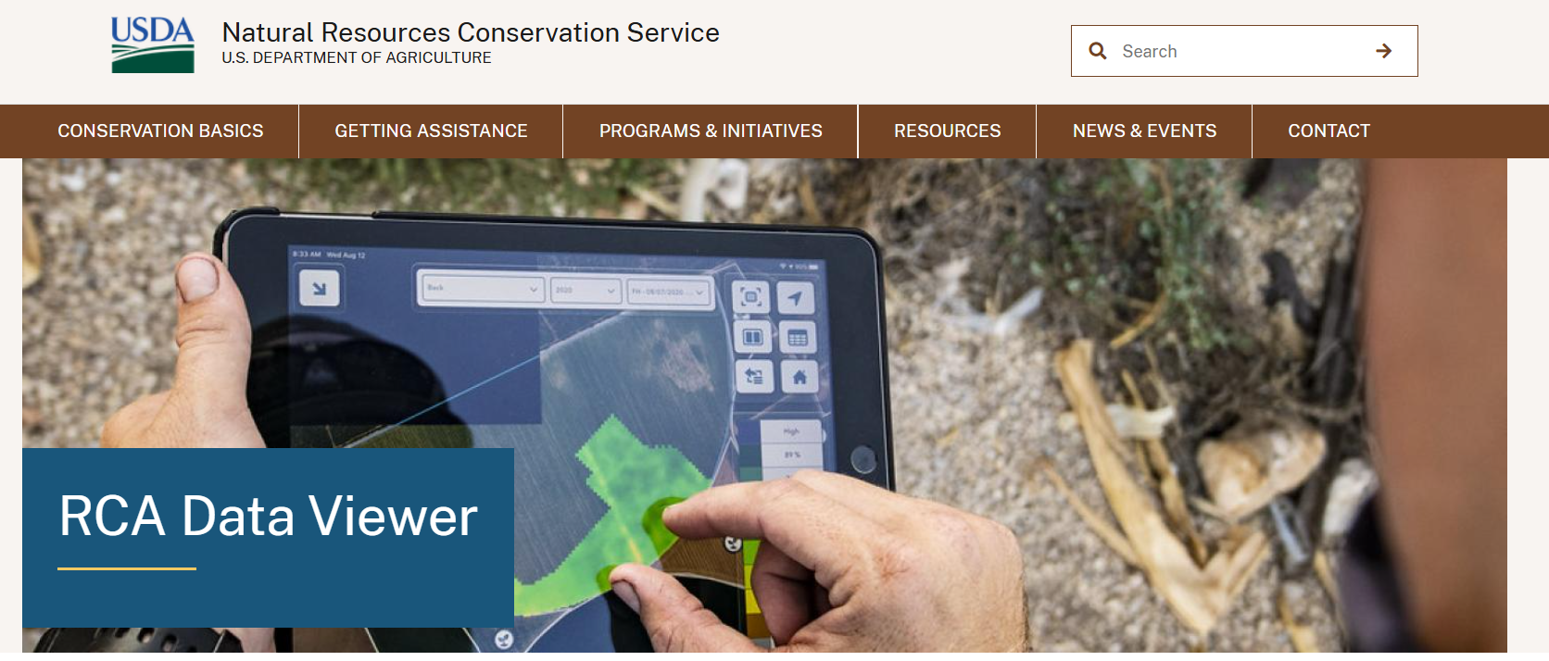
LIVE DEMO
https://www.nrcs.usda.gov/resources/data-and-reports/rca-data-viewer

Slide 9

Andi N. Bailey
Andi.Neugebauer-bailey@usda.gov
307-359-8662

