Slide 1
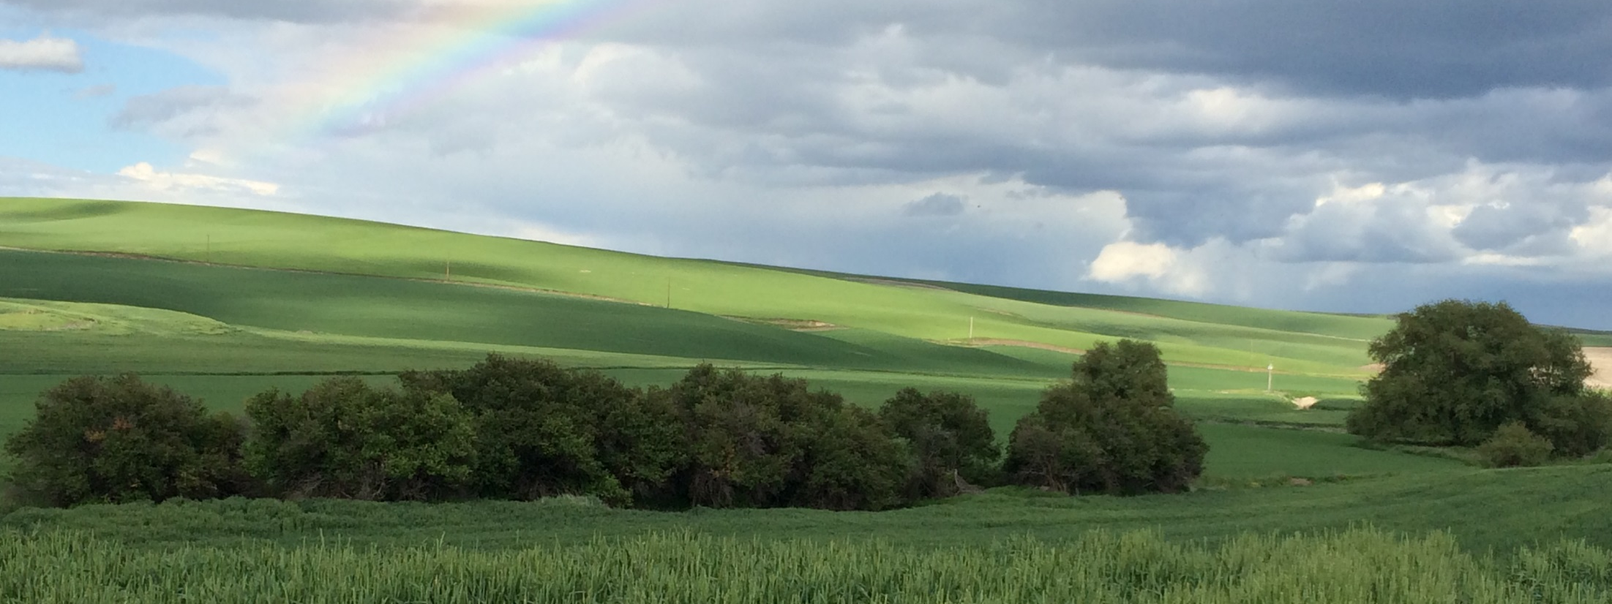



Updates on SCC’s Science Hub
Levi Keesecker, PhD
Science Hub Lead & Ecosystems Manager
STAC
February 2025
Notes:
Cover photo dimensions: 5x13.33

Slide 2
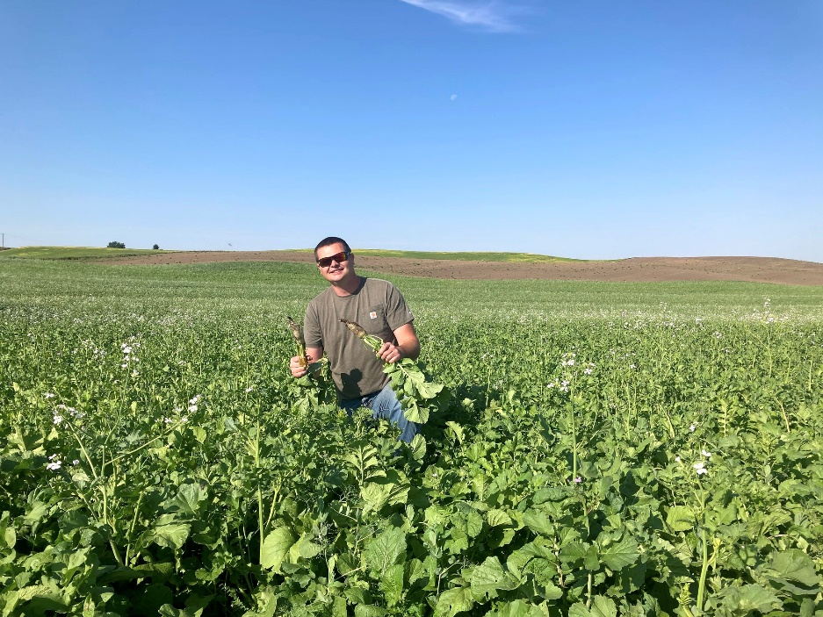
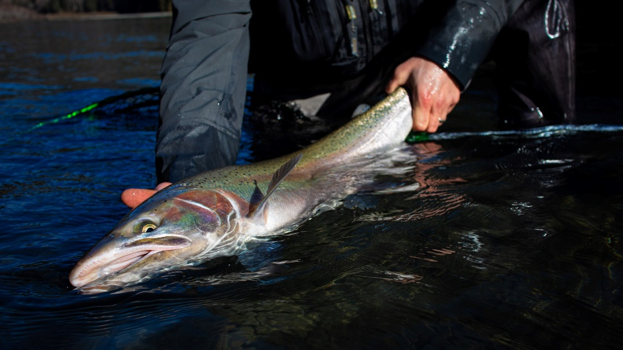
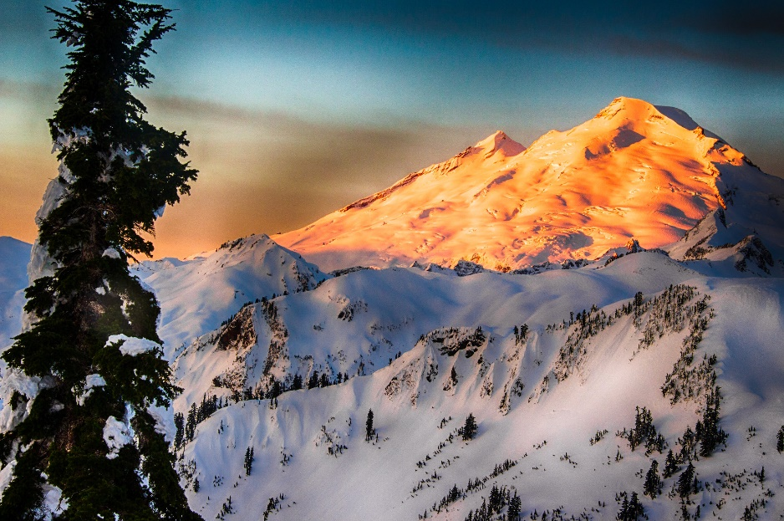
What is the Science Hub?
Demonstrate co-benefits of conservation practices within watersheds
Agricultural Viability
Ecosystem Health
Climate Resilience
Proviso - $1 million (2023-2025)

Slide 3









What is the Science Hub?
Connect scientists, practitioners, and researchers
Coordinated Resource Management
Community Participation
Watershed Monitoring
Watershed Planning & Prioritization
+ more
Agricultural Viability

Slide 4

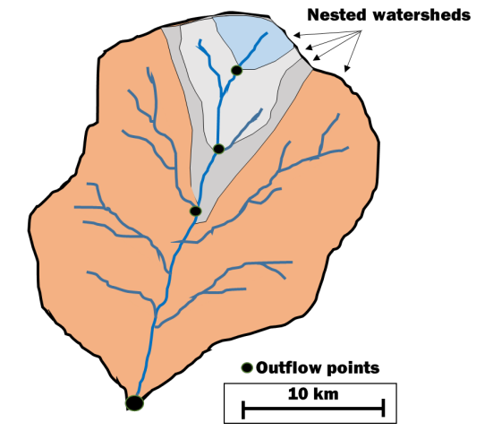
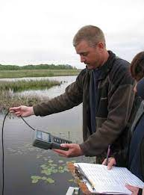
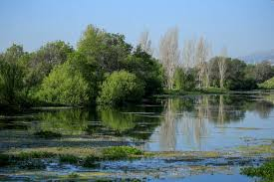


What are the effects in the watershed?
VSP counties must demonstrate that critical area functions and values are protected or enhanced – at the watershed scale - relative to July 2011

Slide 5
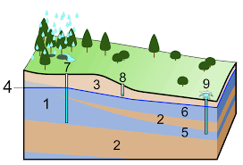

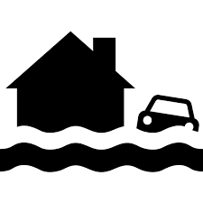
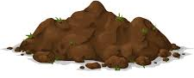
What are the effects in the watershed?
Critical Area Types
Functions*
Wetlands
Flood Storage – Water Quality Improvement – Shoreline & Erosion Control – Natural Products – Habitat for F & W
Critical Aquifer Recharge Areas
Water Quality Improvement – Drinking Water Provisioning – Hyporheic Input for Streams & Rivers
Fish & Wildlife Conservation Areas
Migration Corridors – Vegetative Cover – Food/Habitat for Fish & Wildlife – Pollination of Wild/Cultivated Plants
Frequently Flooded Areas
Flood Storage – Reduced Erosion/Sedimentation – Groundwater Recharge – Hydrologic Connectivity – Nutrient/Sediment Distribution
Geologically Hazardous Areas
Erosion Prevention – Landslide Prevention – Habitat for
F & W – Sediment Input in Streams/Rivers
*Not an exhaustive list

Slide 6
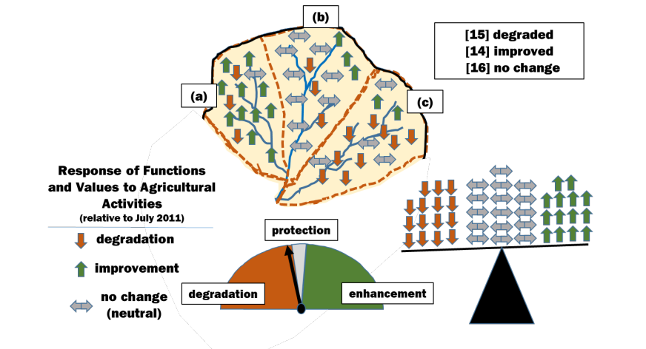

Slide 7
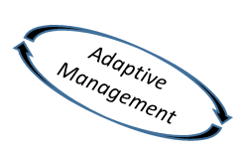



VSP Watershed Work Groups
Operationalize data to make decisions
*Conservation District staff*
County Water Dept.
Ag Producers
Land Rights Group Rep.
College Professor
Tribal Staff
Lands Council member
Orchardist
Dairy Association member
Others
State Fish & Wildlife Dept. staff
VSP Work Groups

Slide 8



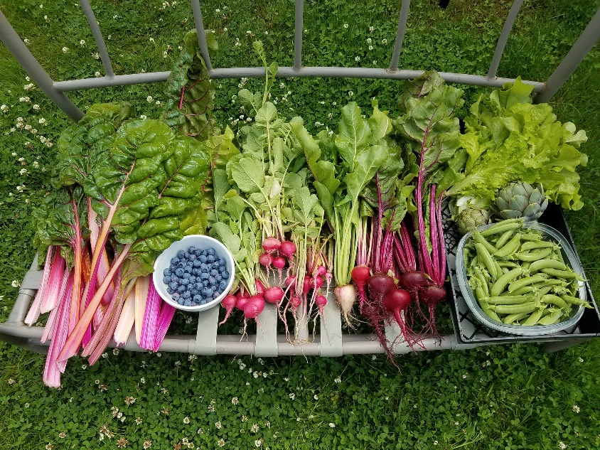
Pilot Watersheds
Focal Activities
Coordinated Resource Management
  LiDAR
Watershed Planning & Prioritization
Watershed Monitoring
Social: values, motivations, economics, language, trust

Slide 9
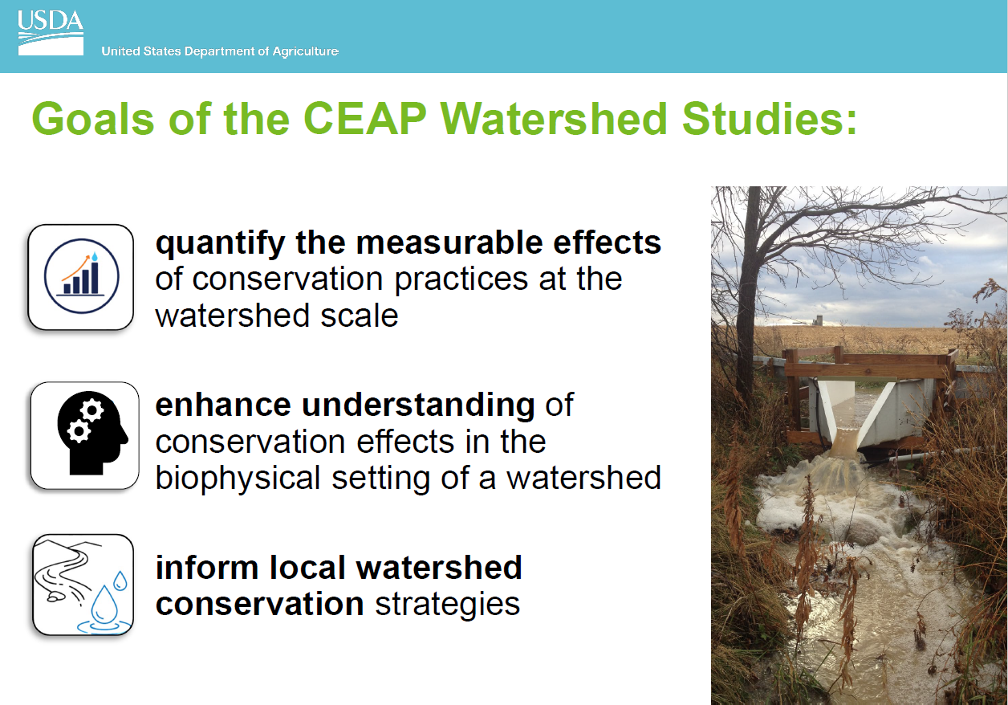
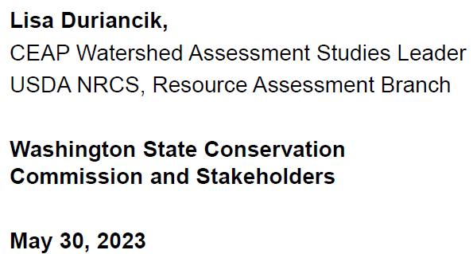

Slide 10

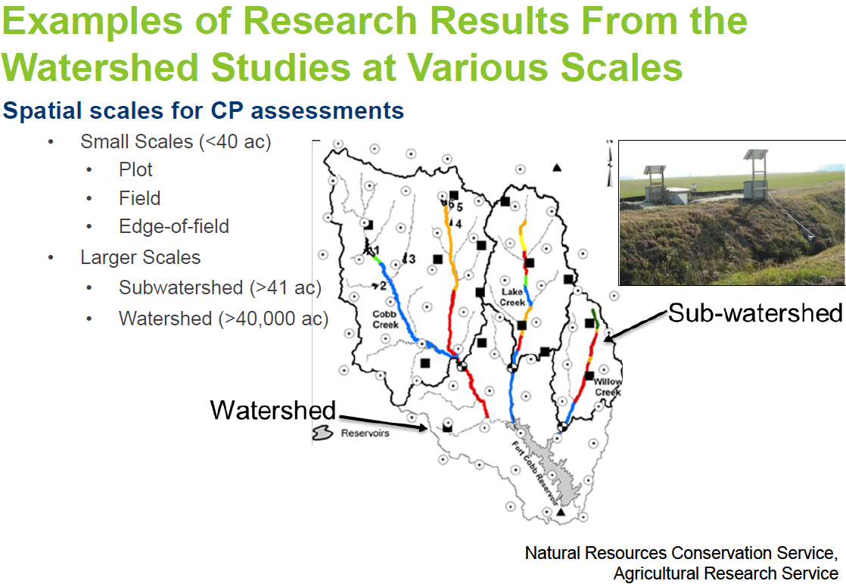
Effects of conservation
Watershed Monitoring

Slide 11

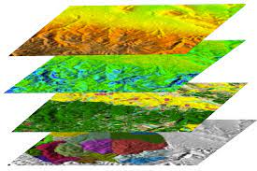
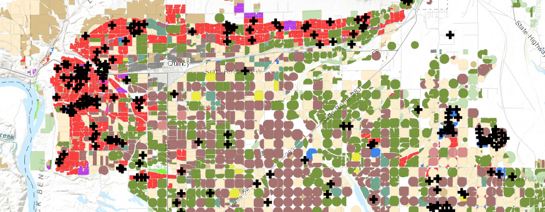
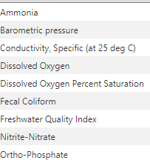
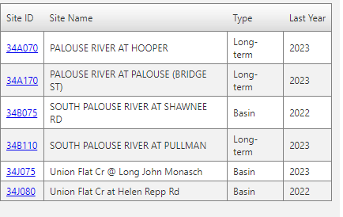
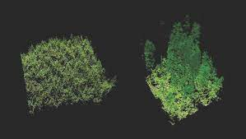
Leveraging data & collaboration
Watershed Monitoring
  Satellite imagery
  LiDAR

Slide 12

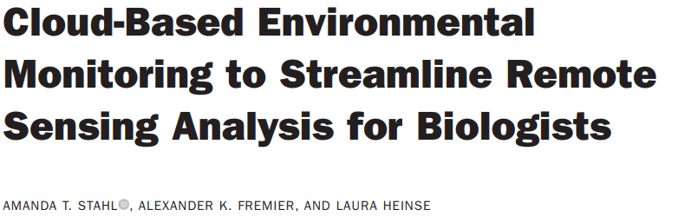
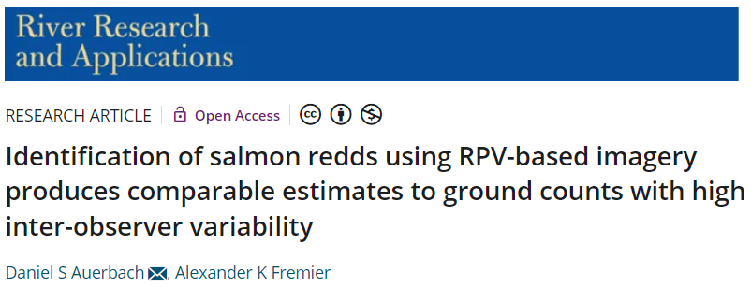
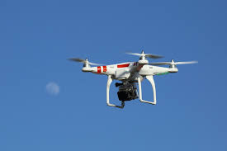

Watershed Monitoring
  Drones

Slide 13
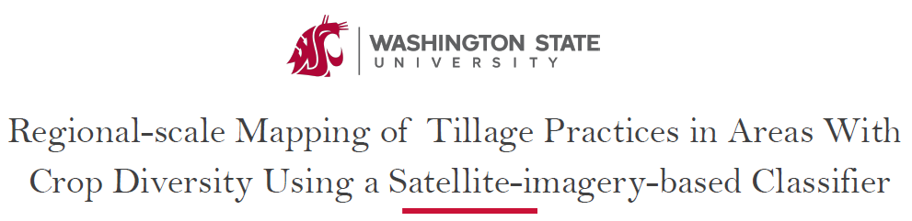
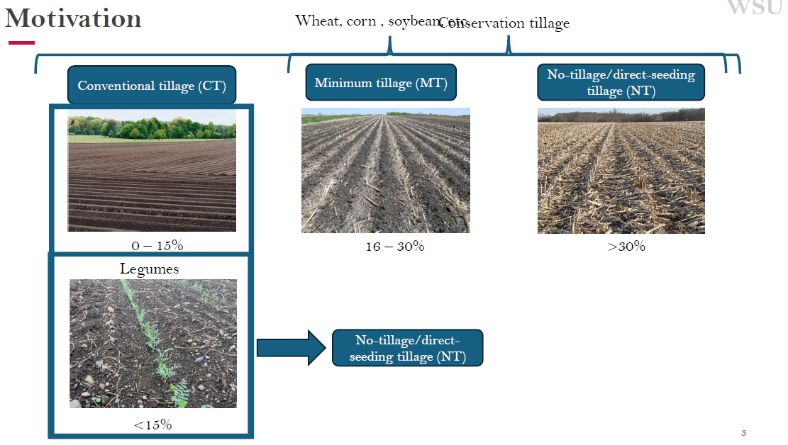
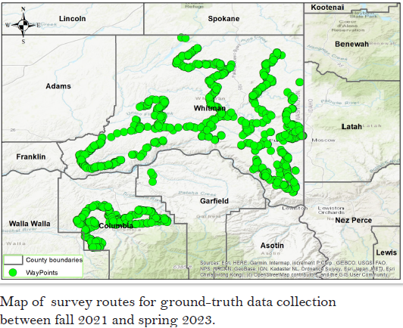
Watershed Monitoring
  LiDAR

Slide 14
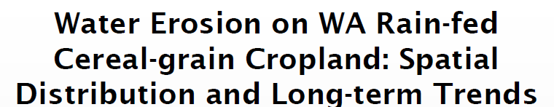
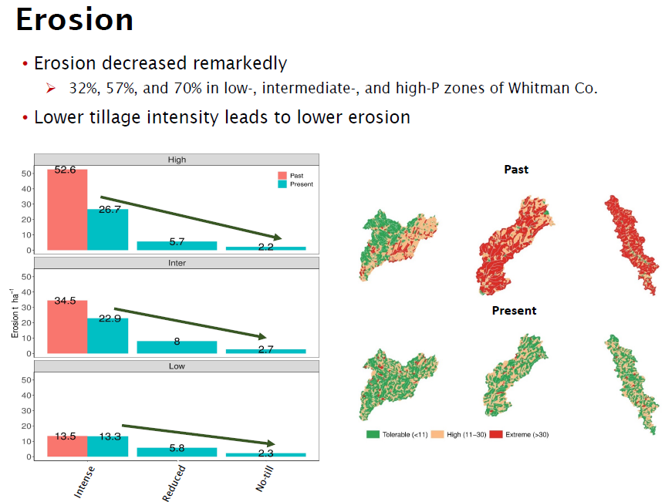




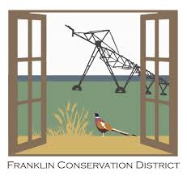


Slide 15
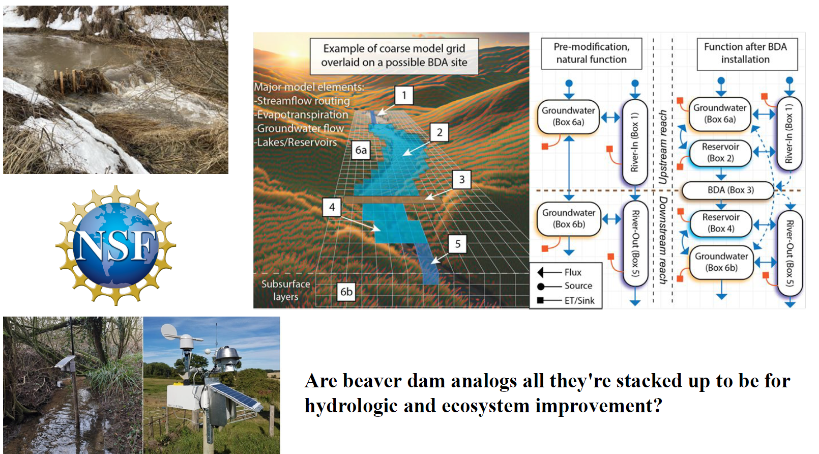

Slide 16
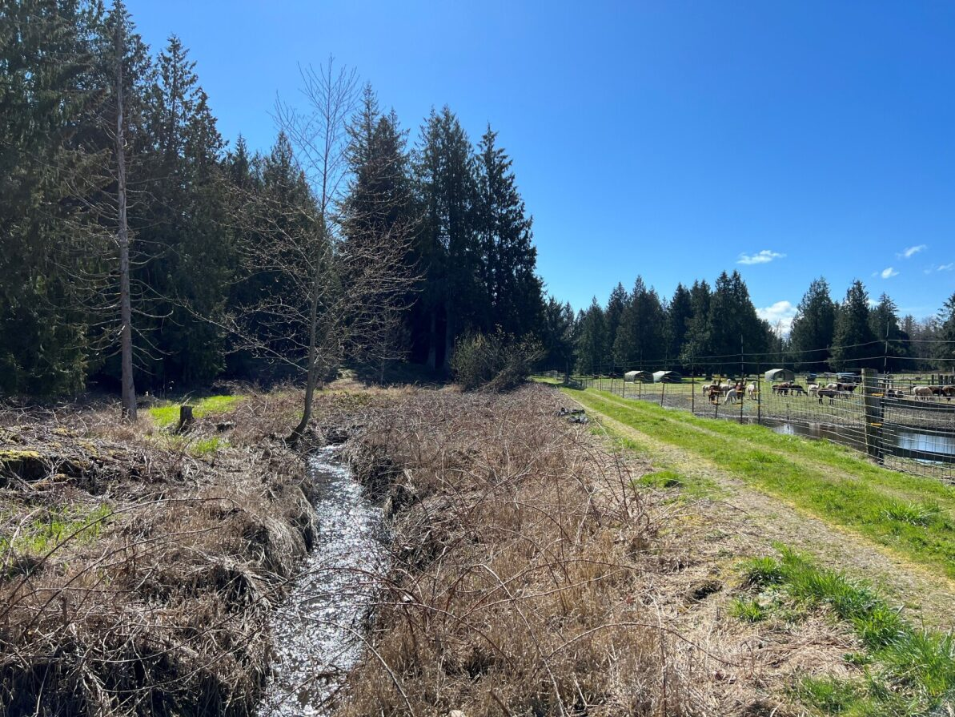
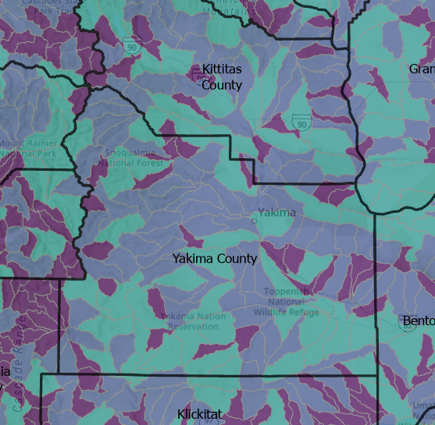
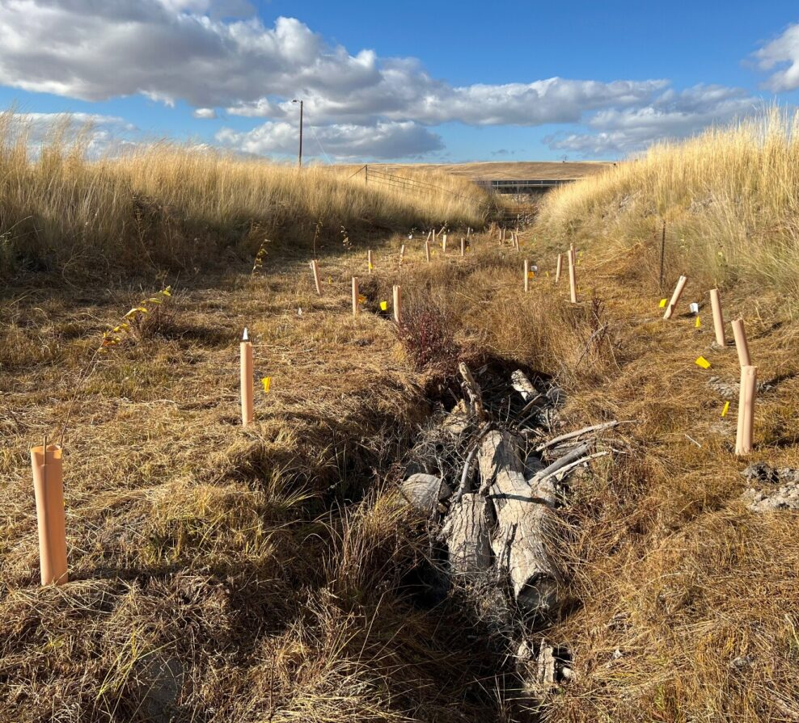
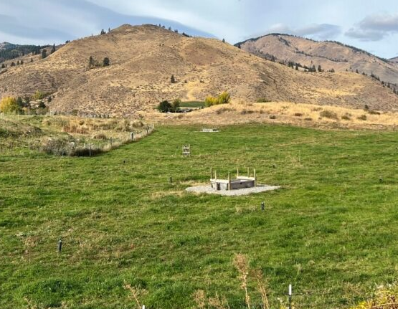
Implementing Conservation
Watershed Planning & Prioritization
Operationalize the data

Slide 17
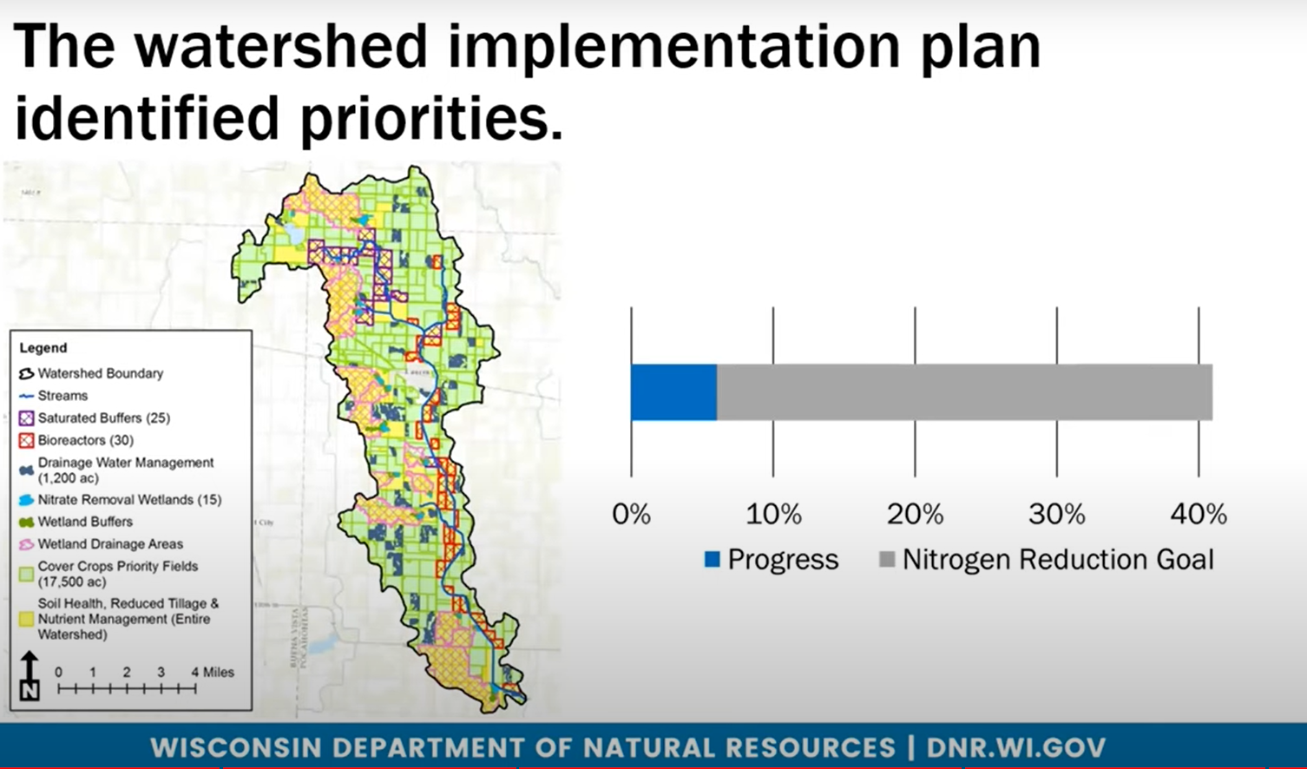

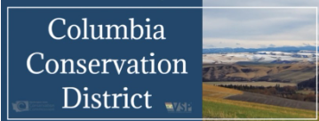


Watershed Planning & Prioritization
  LiDAR
Piloting work in 6+ watersheds
Applications to monitoring, planning, benchmarks, outreach, and agricultural viability
Working with developers to calibrate for PNW

Slide 18
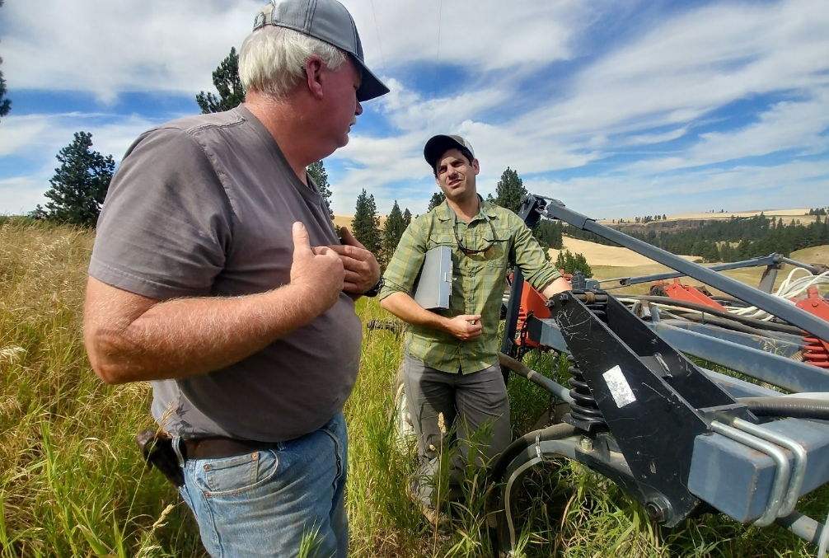
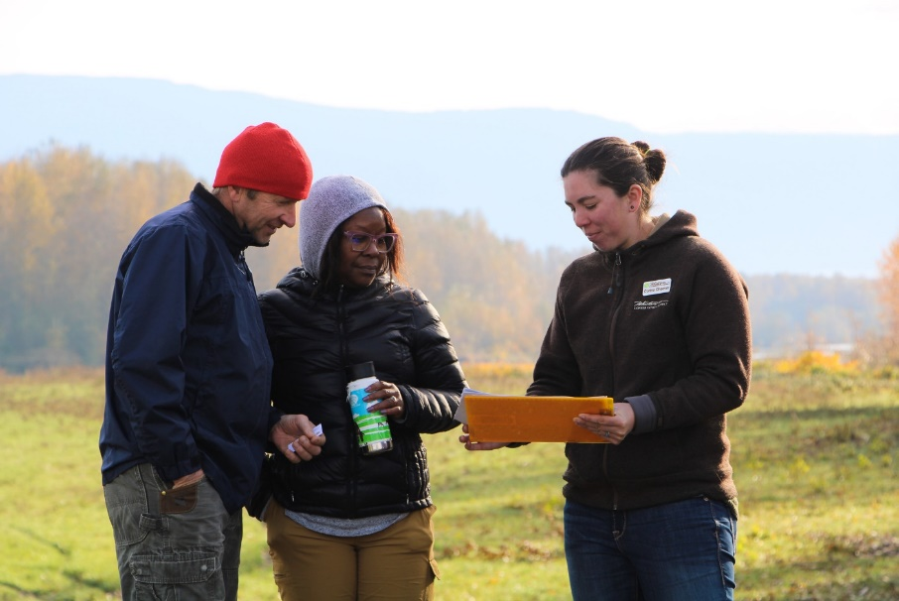
Social: values, motivations, economics, language, trust
Community & Participation
Understand values and motivations of land stewards to implement voluntary incentive programs
Community-Based Social Marketing
Trust and Relationships
$$$ & Economics

Slide 19
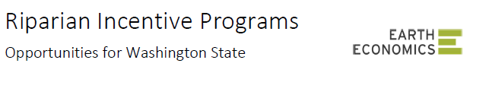
$$$ & Economics
Take home messages:
Flexible design –
Adaptive management
$$ based on performance and lost revenues
Catalyze resources –
$$ for outreach, education & monitoring
Coordinating partnerships
Engender trust –
private owners & orgs/gov’t
tax benefits and incentive structures
increase connection to local watershed
  LiDAR

Slide 20

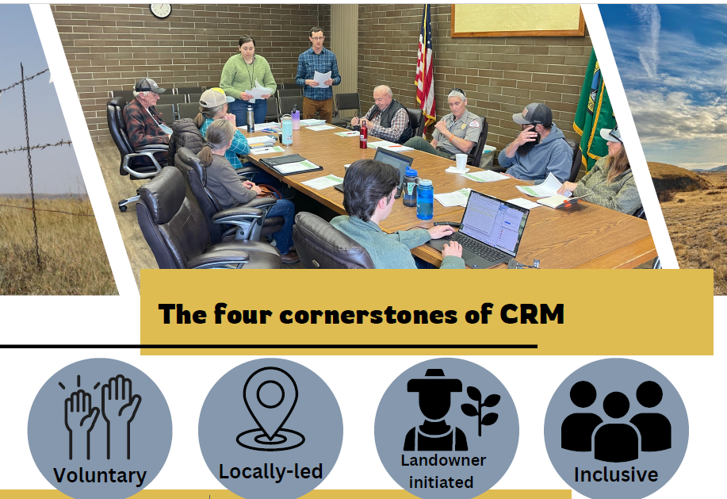

Community & Participation
Trust and Relationships

Slide 21
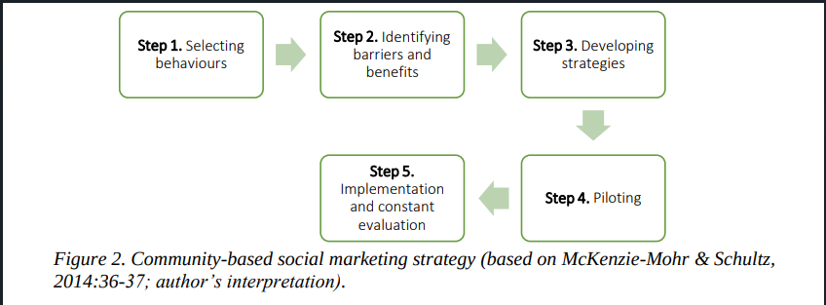
Community & Participation
Community-Based Social Marketing

Slide 22

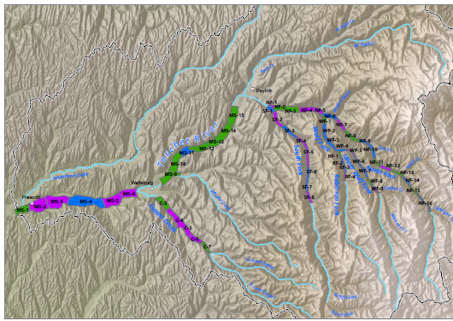



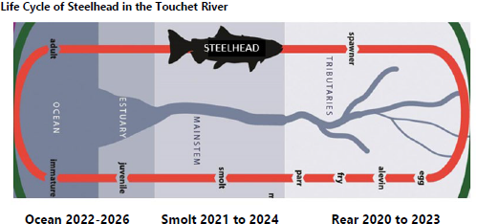
Columbia Co. – Touchet watershed

Slide 23
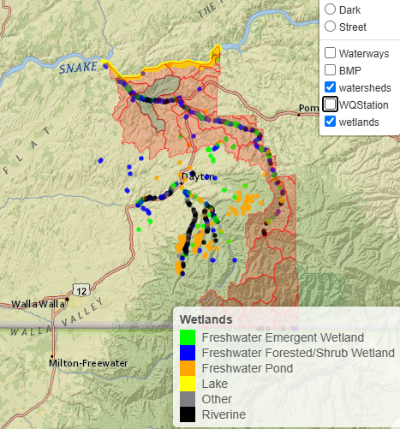
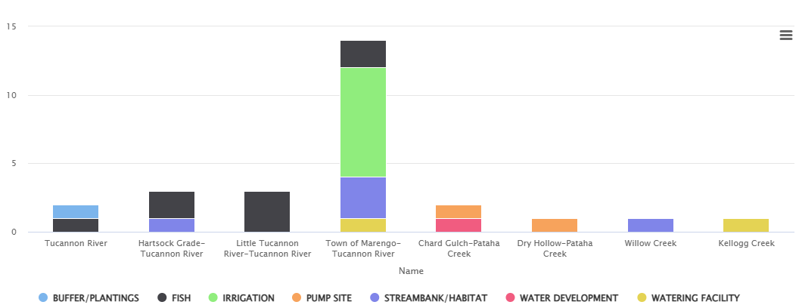
Columbia Co. – Touchet watershed

Slide 24

Columbia Co. – Touchet watershed
$$$ & Economics
Trust & Relationships
Erosion & soil health

Slide 25
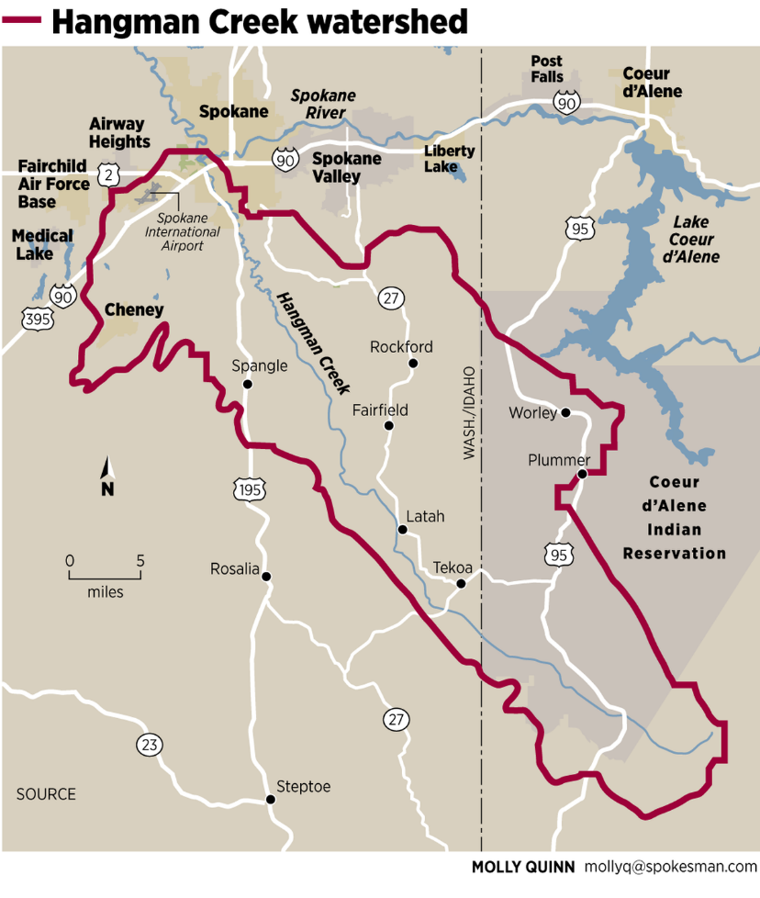
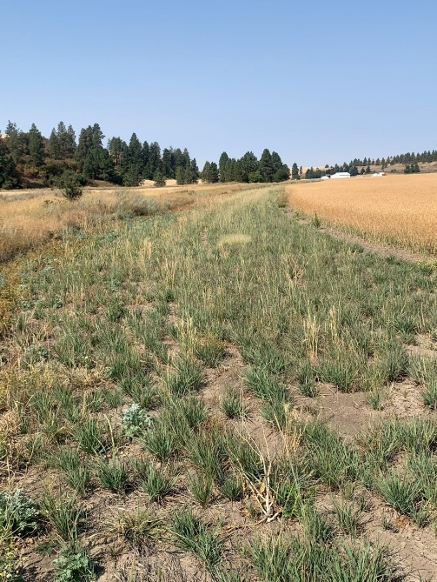
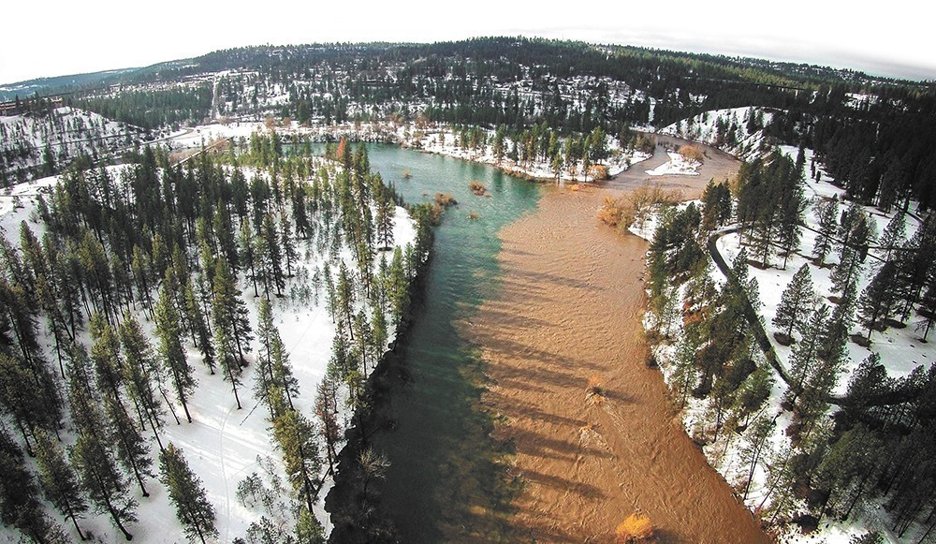
Spokane Co.
Hangman & Little Spokane watersheds
+ more

Slide 26

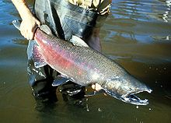

Spokane Co.
Hangman & Little Spokane watersheds
Erosion & soil health
+ more
Salmonid & Trout Habitat Modeling
$$$ & Economics
Trust & Relationships

Slide 27



Spokane Co.
Hangman & Little Spokane watersheds
+ more

Slide 28



Watershed Monitoring
Biofarming & Regenerative Ag
Soil chemical and physical properties
Water dynamics
Soil microbiology
Plants
Invertebrates
Birds
Crops and Forage
Economics
$$$ & Economics
Farmer networks
Training
Agricultural Viability
Baseline assessments from 10+ farms
Spokane Co, Whitman Co, Lincoln Co, Asotin Co.

Slide 29




Amplify what is learned
Share with each other
Apply to our work

Slide 30


Science can help us tell the story
of voluntary conservation
We have tools needed
Opportunities for workforce development & training
Collaboration & strategic coordination is key
+ more

Slide 31


Thank you!
Contact:
Levi Keesecker, PhD
Ecosystems Manager & Science Hub Lead
lkeesecker@scc.wa.gov
360-789-3650
Notes:
Closing image dimensions: 5.5x5.3

